Slide 1
Developing Secure Applications using Azure AD
Notes:
This module begins with a primer on OAuth 2.0 and OpenID Connect and an overview of the Azure Active Directory security model which provides support for user authentication, application authentication and an authorization scheme based on configurable permissions. Students will learn about the differences between application permissions and delegated permissions as well as how to create and configure Azure AD applications in the new Azure portal. Students will learn programming techniques for developing secure applications which implement common authentication flows such as user credentials flow, authorization grant flow, and client credentials flow. The module examines developing secure ASP.NET MVC application by using the Active Directory Authentication Library (ADAL) together with the OWIN framework and OWIN middleware components. The module also explains how to secure client-side SPAs created Angular and AngularJS by using the ADAL.js library and the implicit grant flow to acquire access tokens.

Slide 2
Agenda
Understanding OAuth 2.0 and OpenID Connect
Creating & Configuring Azure AD Applications
Acquiring Access Tokens with MSAL
Implementing Implicit Flow
Implementing Authorization Code Flow

Slide 3
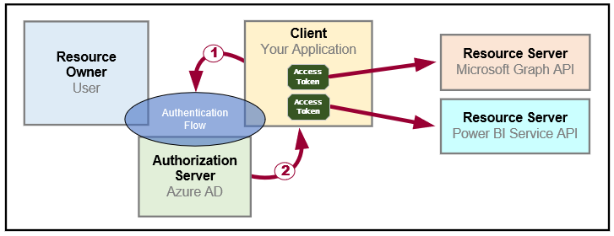
OAuth 2.0 Fundamentals
Client application calls to resource server on behalf of a user
Client implements authentication flow to acquire access token
Access token contains permission grants for client to call resource server
Client passes access token when calling to resource server
Resource server inspects access token to ensure client has permissions

Slide 4
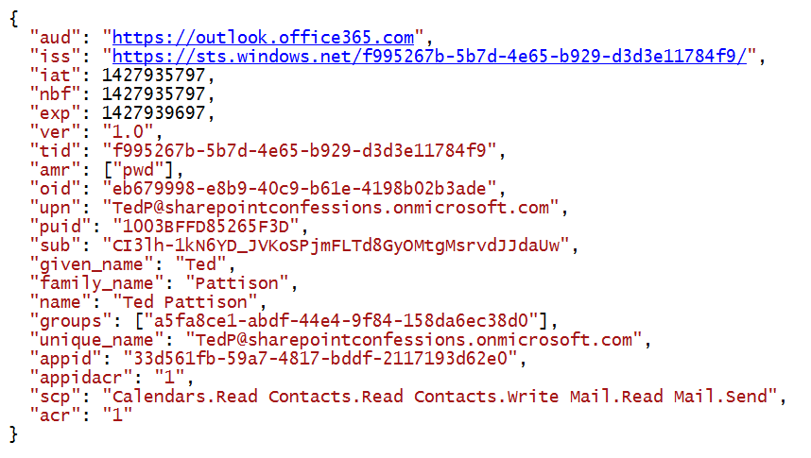
Access Token is a Bearer Token
It can be used by any who bears (e.g. steals) it
Always encrypt with HTTPS when transmitting access tokens

Slide 5
OAuth 2.0 Client Registration
Client must be registered with authorization server
Authorization server tracks each client with unique Client ID
Client should be registered with one or more Reply URLs
Reply URL should be fixed endpoint on Internet
Reply URL used to transmit security tokens to clients
Client registration tracks permissions and other attributes

Slide 6
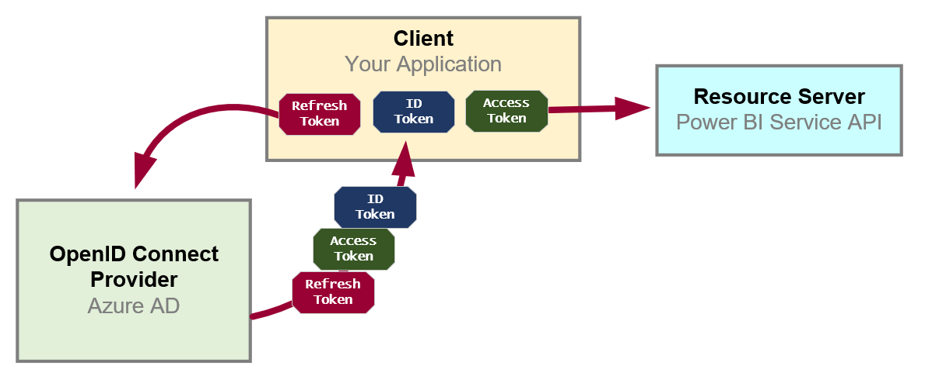
OpenID Connect Extends OAuth 2.0
OAuth 2.0 has shortcomings with authentication & identity
It does not provide client with means to validate access tokens
Lack of validation makes client vulnerable to token forgery attacks
Open ID Connect is standard which extends OAuth 2.0
OpenID Connect provider passes ID token in addition to OAuth 2.0 tokens
OpenID Connect provider provides client with keys for token validation

Slide 7
Authentication Flows
User Password Credential Flow (public client)
Used in Native clients to obtain access code
Requires passing user name and password across network
Device Code Flow (public client)
New style of authentication introduced with Azure AD v2 Endpoint
Client Credentials Flow (confidential client)
Authentication based on password or certificate held by application
Used to obtain app-only access tokens
Implicit Flow (public client)
Used in SPAs built with JavaScript and AngularJS
Application obtains access token w/o acquiring authorization code
Authorization Code Flow (confidential client)
Client first obtains authorization code sent back to browser
Client then obtains access token in server-to-server call

Slide 8
Agenda
Understanding OAuth 2.0 and OpenID Connect
Creating & Configuring Azure AD Applications
Acquiring Access Tokens with MSAL
Implementing Implicit Flow
Implementing Authorization Code Flow

Slide 9
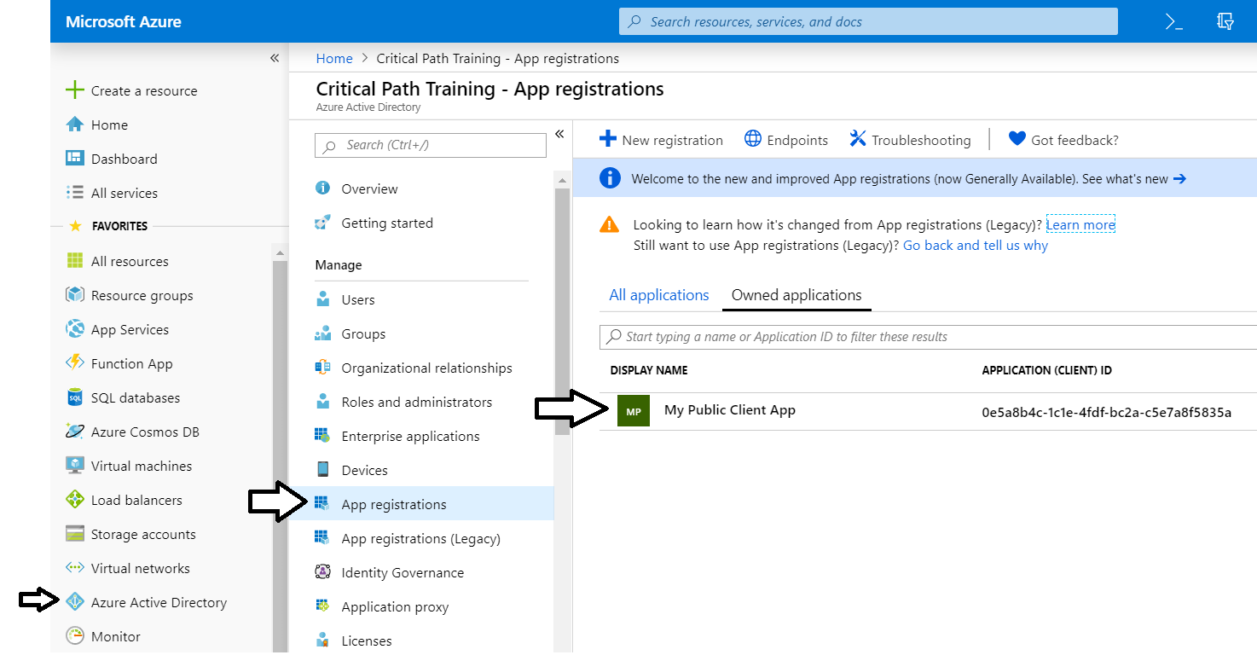
The Azure Portal
Azure portal allows you to register Azure AD applications
Azure Portal accessible at https://portal.azure.com
No Azure subscription required to register applications

Slide 10
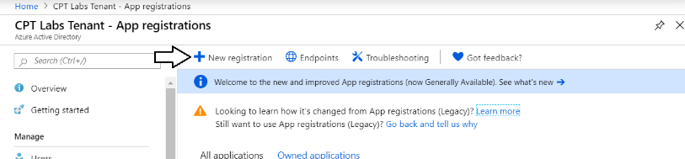
Azure AD Applications
Creating applications required for AAU authentication
Applications are as Native application or Web Applications
Application identified using GUID known as application ID
Application ID often referred to as client ID or app ID

Slide 11
Questions To Ask When Creating Application
Where are my users?
Inside a single tenant
Inside any Microsoft 365 tenant
Inside a Microsoft 365 tenant or
Where does the application run? Can it keep a secret?
Pubic client versus Confidential client
Should the app work on behalf of a user or work as itself?
Should access tokens be created as user tokens or app-only tokens
When and how should permissions be requested and granted?
when should the app ask the user for permissions to a resource

Slide 12
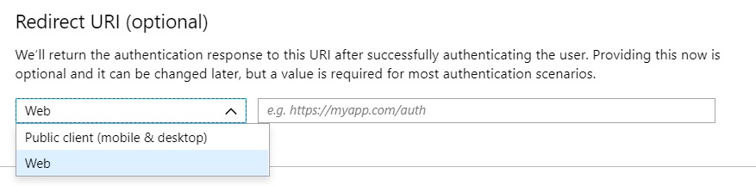
Application Types
Azure AD Application Types
Public client (mobile and desktop)
Web

Slide 13
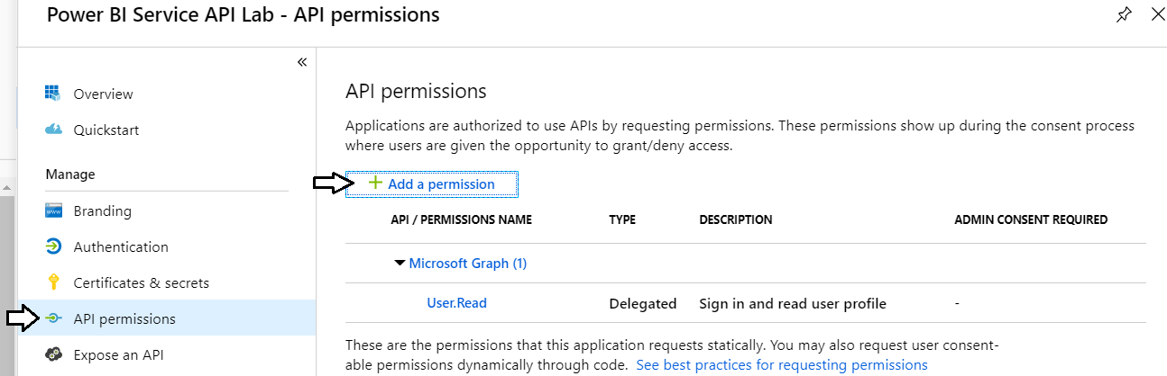
Configuring Required Permissions
Application configured with permissions
Default permissions allows user authentication – but that's it
To use APIs, you can assign permissions to the application

Slide 14
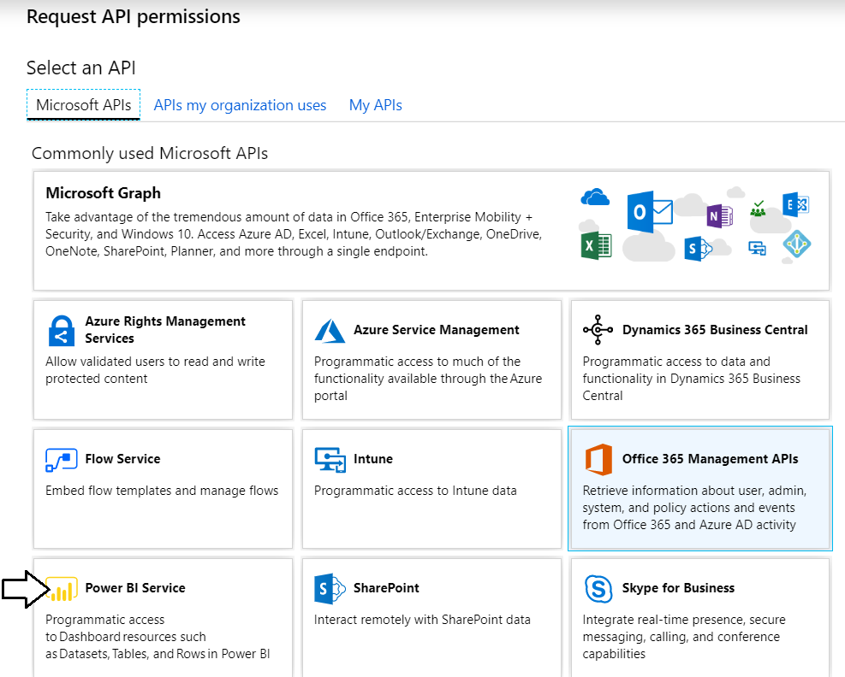
Choosing an API
There are lots of APIs to choose from
Microsoft Graph, Power BI Service, etc.

Slide 15
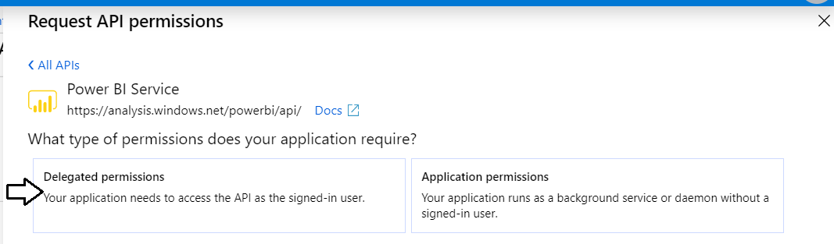
Delegated Permissions vs Application Permissions
Permissions categorized into two basic types
Delegated permissions are (app + user) permissions
Application permissions are app-only permissions (far more powerful)
Not all application types and APIs support application permissions
Power BI Service API does not support application permission

Slide 16
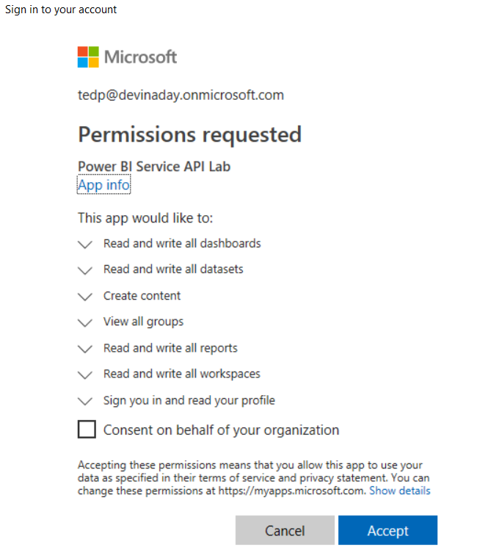
Interactive Consent for Delegated Permissions
Users must consent to delegated permissions
User prompted during first log in
User must click Accept
Only occurs once for each user

Slide 17
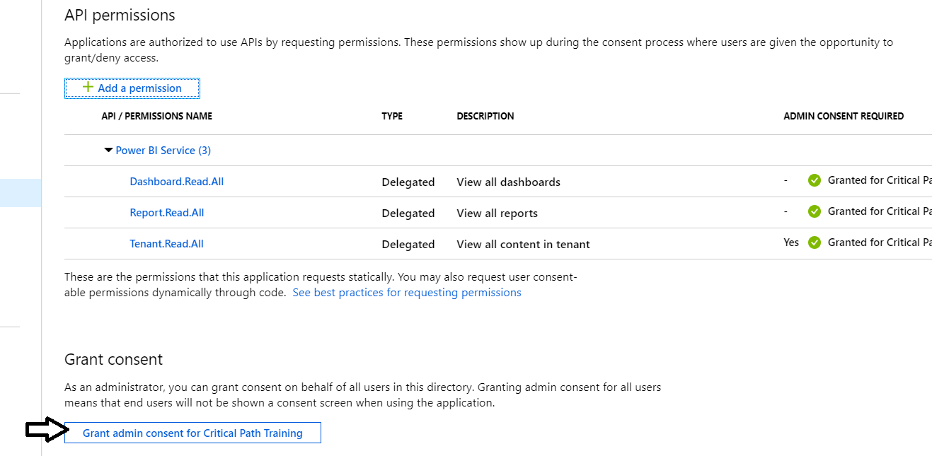
Granting Delegated Permissions
It can be helpful to Grant Permissions in Azure portal
Prevents the need for interactive granting of application by user
Might be required when authenticating in non-interactive fashion

Slide 18
Applications and Service Principals
Azure AD creates service principal(s) for each application
Service principle created once per tenant
Service principle acts as first-class AAD security principal
Host Tenant
Tenant 2
Tenant 3
Application
Application ID
Service Principal
Object ID
Service Principal
Object ID
Service Principal
Object ID
Permission Grants
User1
User2
Permission Grants
User1
User2
Permission Grants
User1
User2

Slide 19
Applications versus Service Principle
Application defined once across all tenants
Identified using global Application ID
Application object lives in tenant where it’s registered
Defines auth type, secrets and required permissions
Service principal created once per tenant
Identified using tenant-specific Object ID
Used to track permission grants for user consent

Slide 20
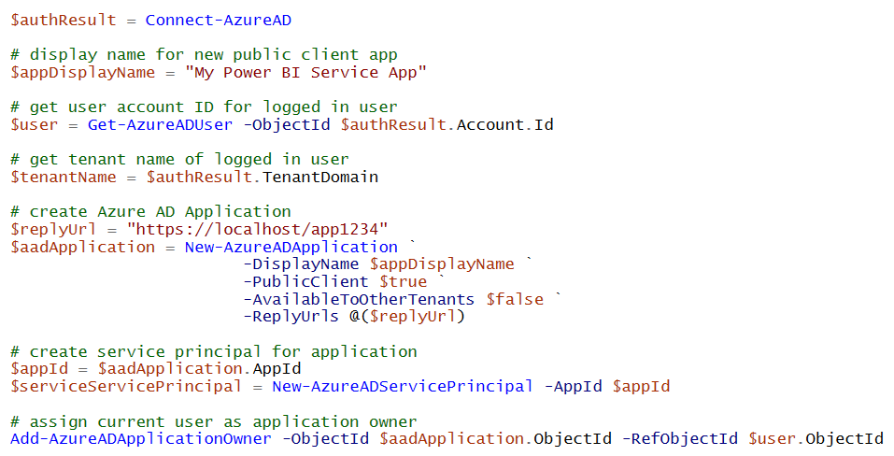
Registering AAD Apps with PowerShell

Slide 21
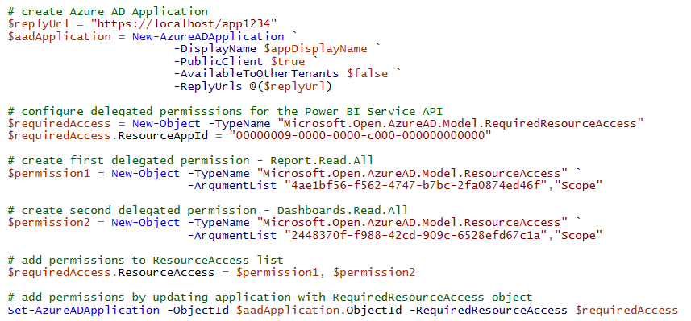
Configuring Delegated Permissions

Slide 22
Creating an AAD Application

Slide 23
Agenda
Understanding OAuth 2.0 and OpenID Connect
Creating & Configuring Azure AD Applications
Acquiring Access Tokens with MSAL
Implementing Implicit Flow
Implementing Authorization Code Flow

Slide 24
Authenticating with Azure AD
Custom applications must authenticate with Azure AD
Your code implements an authentication flow to obtain access token
Access token must be passed when calling resource (e.g. Microsoft Graph API)
Microsoft supports two endpoints for programming authentication
Azure AD V1 endpoint (released to GA over 8 years ago)
Azure AD V2 endpoint (released to GA in May 2019)
Azure Active Directory
Custom App
Access Token
Access Token
Microsoft
Graph API

Slide 25

Azure AD Endpoints and Libraries
Authenticating with the Azure AD V1 Endpoint
Heavily used over the last 5-6 years
Accessed through Azure AD Authentication Library (ADAL)
Authenticating with the Azure AD V2 Endpoint
Moved from preview to GA in May 2019
Accessed through Microsoft Authentication Library (MSAL)
Why move to the Azure AD V2 Endpoint?
Dynamic Incremental consent
New authentication flows (e.g. device code flow)

Slide 26
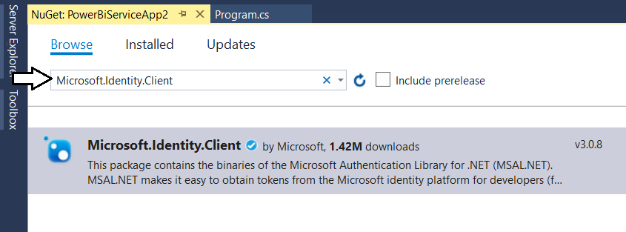
Microsoft Authentication Library (.NET)
Developing with the Microsoft Authentication Library
Provides access to Azure AD V2 Endpoint
Added to project as Microsoft.Identity.Client NuGet package
Provides different classes for public clients vs confidential clients

Slide 27
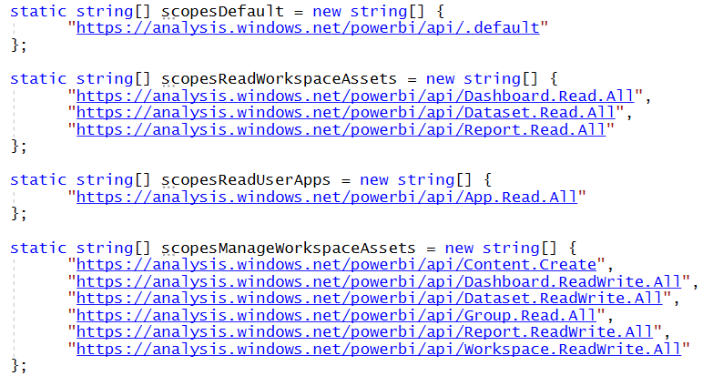
Power BI Service API Scopes
Azure AD V2 endpoint requires passing scopes
Scopes define permissions required in access token
Scopes defined as resource + permission https://analysis.windows.net/powerbi/api/ + Report.ReadWrite.All

Slide 28
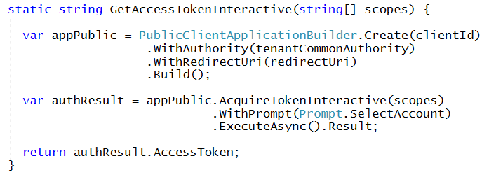
Interactive Access Token Acquisition Using MSAL with public client application
Flow implemented using PublicClientApplication object
Created using PublicClientApplicationBuilder object
Requires passing redirect URI
You can control prompting behavior

Slide 29
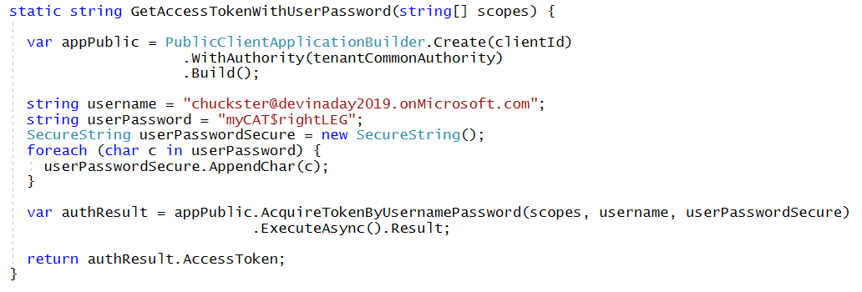
User Credential Password Flow Using MSAL with public client application
MSAL supports user credential password flow
Supported in .NET runtime but not in .NET CORE
Microsoft recommends against using this flow

Slide 30
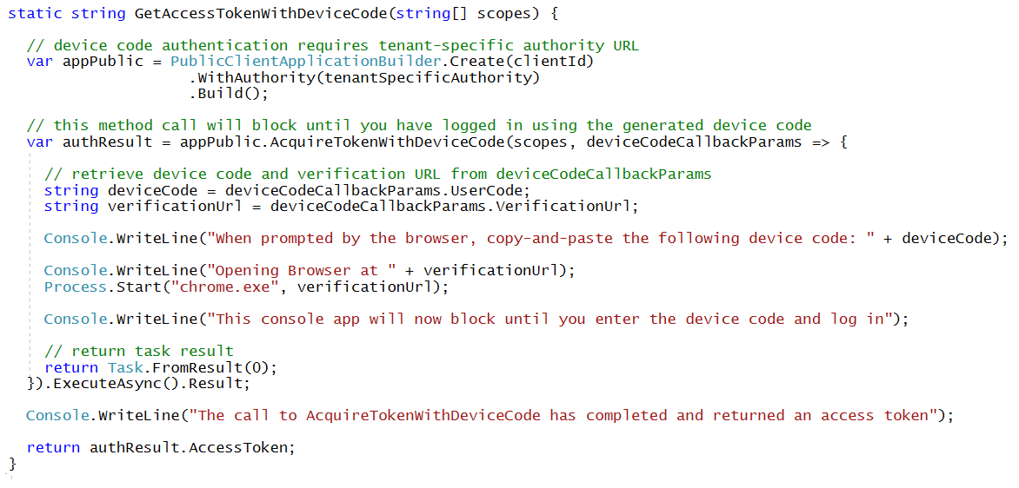
Device Code Flow Using MSAL with public client application
MSAL introduced this new flow with MSAL
Much more secure than user password credential flow
Not available in ADAL

Slide 31
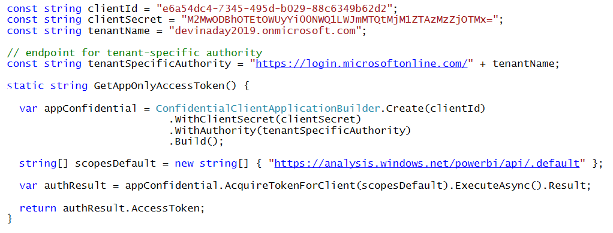
Client Credentials Flow Using MSAL with confidential client application
Client credentials flow used to obtain app-only token
Requires passing app secret (e.g. app password or certificate)
Requires passing tenant-specific endpoint

Slide 32
Agenda
Understanding OAuth 2.0 and OpenID Connect
Creating & Configuring Azure AD Applications
Acquiring Access Tokens with MSAL
Implementing Implicit Flow
Implementing Authorization Code Flow

Slide 33
Understanding Implicit Flow
Single Pages Applications (SPAs) are public clients
SPA not able to keep secrets such as application secret
No ability to execute server-to-server calls
SPAs cannot implement authorization code flow
Implicit flow requires lowering security bar for SPAs
Azure AD application must be configured to allow implicit flow
Allows SPAs to retrieve access tokens
Access token returned to browser in URL fragment

Slide 34
Agenda
Understanding OAuth 2.0 and OpenID Connect
Creating & Configuring Azure AD Applications
Acquiring Access Tokens with MSAL
Implementing Implicit Flow
Implementing Authorization Code Flow

Slide 35
Authorization Code Grant Flow
Provides Highest Levels of Security
User credentials never seen by client
Access token passed to client with Reply URL
Access token not passed through user agent
Refresh tokens used to get new access tokens
Access token lifetime is about 1 hour
Refresh token lifetime is 14 days
AAD supports multi-resource refresh tokens (MRRTs)

Slide 36
Authorization Code Grant Flow Example
Sign-on URL
Development: https://localhost:44300/
Production: https://www.MyDomain.com/
Reply URL
Development: https://localhost:44300/AcceptDirect
Production: https://www.MyDomain.com/AcceptDirect
Client ID
GUID-based identifier for a specific AAD application
33d561fb-59a7-4817-bddf-2117193d62e0
Key (aka Client Secret)
Key that acts as a secret password between Azure AD and application
ouWdhd2LxDl0Pcu2SKlujEiQ5GmSbKRbBM24nETb5dw=

Slide 37
Authorization Code Grant Flow
Sequence of Requests in Authorization Code Grant Flow
Application redirects to AAD authorization endpoint
User prompted to sign in using Windows logon page
User prompted to consent to permissions (first access)
AAD redirects to application with authorization code
Application calls to AAD token endpoint to acquire access token
Request authorization code
Sign-in via browser pop-up
Return authorization code
Pass authorization code to acquire access token for Power BI Service resource
Return access token and refresh token
Call Power BI Service API using the access token
Return Http Response
Authorization Endpoint
Token Endpoint
Client Application
Power BI Service API

Slide 38
Open Web Interfaces for NET (OWIN)
OWIN interfaces decouple web server from application
OWIN serves to decouple .NET applications from Windows and IIS
OWIN promotes the development of smaller modules (middleware)
Microsoft's Implementation known as Katana
Makes it possible to use OWIN with ASP/NET and ASP Core
Microsoft provides OWIN-based security middleware
Your Web Application
Katana (OWIN implementation for ASP.NET)
OWIN
Web Server and OS

Slide 39
OWIN Middleware Modules
OWIN create pipeline of middleware components
Middleware components added to pipeline on application startup
Middleware components pre-process and post process requests
Middleware components commonly used to set up authentication
OWIN Middleware Pipeline
Browser
Middleware
Component 1
Middleware
Component 2
Web
Application
request
response

Slide 40
OWIN OpenID Connect Module
OpenID Connect module used to implement Authorization Code Flow
Redirects browsers to authorization endpoint
Provides notification when receiving authorization code callback
OWIN Middleware Pipeline
Browser
OWIN
Security
Cookies
OWIN OpenID Connect
Web
Application
request
response

Slide 41
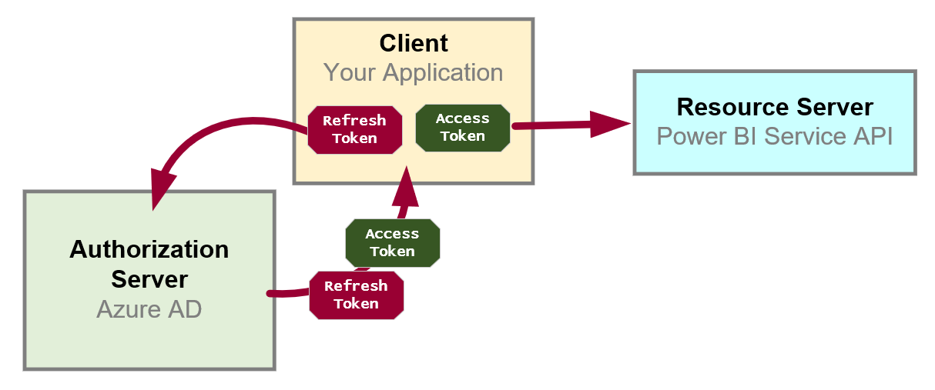
Token Caching and Refresh Tokens
OAuth 2.0 provide solution for access token expiration
Access tokens have default lifetime of 60 minutes
Authorization server passes refresh token along with access token
Refresh token used as a credential to redeem new access token
Refresh token default lifetime is 14 days (max 90 days)
Refresh tokens often persistent in database or browser storage
ADAL and MSAL both offer built-in support to mange token caching

Slide 42
Using ADAL in a Web Client

Slide 43
Summary of OAuth Client Types
 | Web Client SPA | Hybrid Native Client | Web Application Client | Web Service Client
Client Type | Public | Public or Confidential | Confidential | Confidential
Verifiable Reply URL | Yes | No | Yes | Yes
Authenticates Client | No | It Depends | Yes | Yes
Token from Authorization Endpoint | Yes | Yes | No | No
Access Token from URI Fragment | Yes | No | No | No
Token from Token Endpoint | No | Yes | Yes | Yes
Can use refresh tokens | No | Yes | Yes | Yes
Permissions | Delegated | Delegated + App | Delegated + App | Delegated + App

Slide 44
Summary
Understanding OAuth 2.0 and OpenID Connect
Creating & Configuring Azure AD Applications
Acquiring Access Tokens with MSAL
Implementing Implicit Flow
Implementing Authorization Code Flow

